Slide 1

Hashing application to Big Data

Slide 2
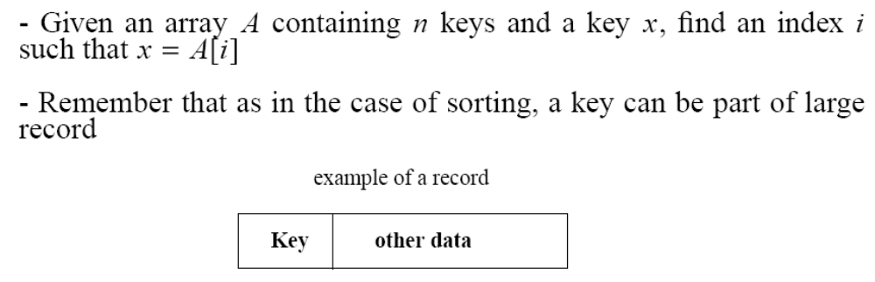
The Search Problem
Find items with keys matching a given search key
  Given an array A, containing n keys, and a search key x, find the index i such as x=A[i]
  As in the case of sorting, a key could be part of a large record.

Slide 3
Applications
Keeping track of customer account information at a bank
  Search through records to check balances and perform transactions
Keep track of reservations on flights
  Search to find empty seats, cancel/modify reservations
Search engine
  Looks for all documents containing a given word

Slide 4
Special Case: Dictionaries
Dictionary = data structure that supports mainly two basic operations: insert a new item and return an item with a given key
Queries: return information about the set S:
  Search (S, k)
  Minimum (S), Maximum (S)
  Successor (S, x), Predecessor (S, x)
Modifying operations: change the set
  Insert (S, k)
  Delete (S, k) – not very often

Slide 5
Direct Addressing
Assumptions:
  Key values are distinct
  Each key is drawn from a universe U = {0, 1, . . . , m - 1}
Idea:
  Store the items in an array, indexed by keys
Direct-address table representation:
  An array T[0 . . . m - 1]
  Each slot, or position, in T corresponds to a key in U
  For an element x with key k, a pointer to x (or x itself) will be placed in location T[k]
  If there are no elements with key k in the set, T[k] is empty, represented by NIL

Slide 6
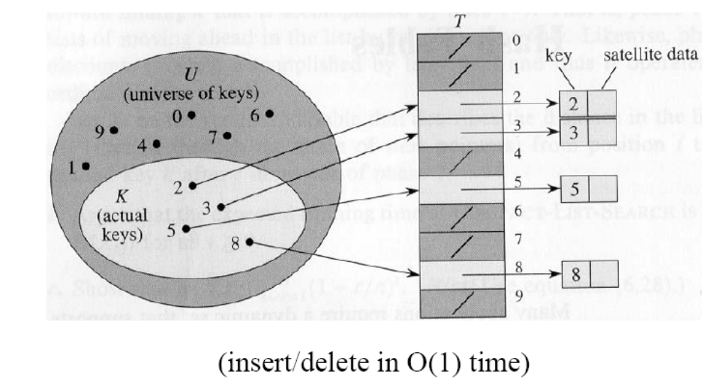
Direct Addressing (cont’d)

Slide 7
Operations
Alg.: DIRECT-ADDRESS-SEARCH(T, k)
return T[k]
Alg.: DIRECT-ADDRESS-INSERT(T, x)
T[key[x]] ← x
Alg.: DIRECT-ADDRESS-DELETE(T, x)
T[key[x]] ← NIL
Running time for these operations: O(1)

Slide 8
Comparing Different Implementations
Implementing dictionaries using:
  Direct addressing
  Ordered/unordered arrays
  Ordered/unordered linked lists
Insert
Search
direct addressing
O(1)
O(1)
ordered array
O(N)
O(lgN)
ordered list
O(N)
O(N)
unordered array
O(1)
O(N)
unordered list
O(1)
O(N)

Slide 9
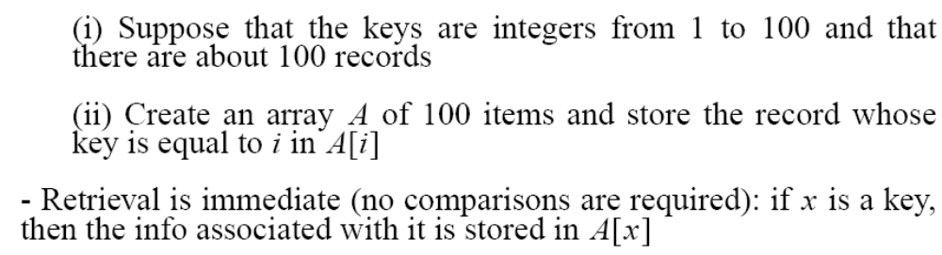
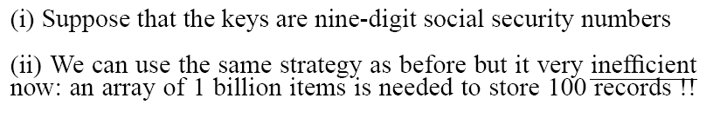
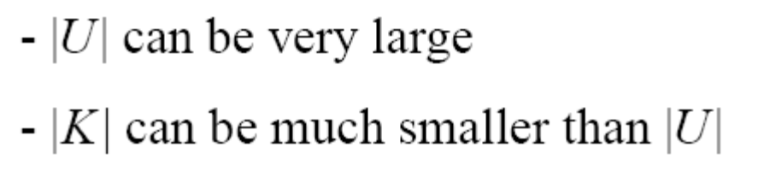
Examples Using Direct Addressing
Example 1:
Example 2:

Slide 10
Hash Tables
When K is much smaller than U, a hash table requires much less space than a direct-address table
  Can reduce storage requirements to |K|
  Can still get O(1) search time, but on the average case, not the worst case

Slide 11
Hash Tables
Idea:
  Use a function h to compute the slot for each key
  Store the element in slot h(k)
A hash function h transforms a key into an index in a hash table T[0…m-1]:
h : U → {0, 1, . . . , m - 1}
We say that k hashes to slot h(k)
Advantages:
  Reduce the range of array indices handled: m instead of |U|
  Storage is also reduced

Slide 12
Example: HASH TABLES
0
U
(universe of keys)
h(k₁)
h(k₄)
k₁
K
(actual
keys)
k₄
k₂
h(k₂) = h(k₅)
k₅
k₃
h(k₃)
m - 1

Slide 13

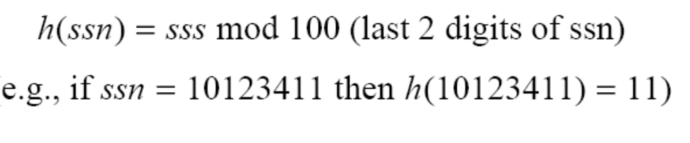
Revisit Example 2

Slide 14
Do you see any problems with this approach?
0
U
(universe of keys)
h(k₁)
h(k₄)
k₁
K
(actual
keys)
k₄
k₂
h(k₂) = h(k₅)
Collisions!
k₅
k₃
h(k₃)
m - 1

Slide 15
Collisions
Two or more keys hash to the same slot!!
For a given set K of keys
  If |K| ≤ m, collisions may or may not happen, depending on the hash function
  If |K| > m, collisions will definitely happen (i.e., there must be at least two keys that have the same hash value)
Avoiding collisions completely is hard, even with a good hash function

Slide 16
Handling Collisions
We will review the following methods:
  Chaining
  Open addressing
    Linear probing
    Quadratic probing
    Double hashing
We will discuss chaining first, and ways to build “good” functions.

Slide 17
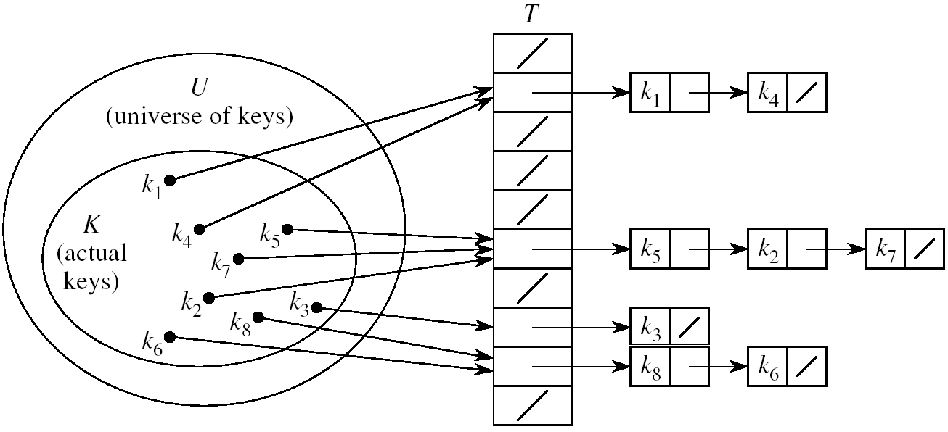
Handling Collisions Using Chaining
Idea:
  Put all elements that hash to the same slot into a linked list
  Slot j contains a pointer to the head of the list of all elements that hash to j

Slide 18
Collision with Chaining - Discussion
Choosing the size of the table
  Small enough not to waste space
  Large enough such that lists remain short
  Typically 1/5 or 1/10 of the total number of elements
How should we keep the lists: ordered or not?
  Not ordered!
    Insert is fast
    Can easily remove the most recently inserted elements

Slide 19
Insertion in Hash Tables
Alg.: CHAINED-HASH-INSERT(T, x)
insert x at the head of list T[h(key[x])]
Worst-case running time is O(1)
Assumes that the element being inserted isn’t already in the list
It would take an additional search to check if it was already inserted

Slide 20
Deletion in Hash Tables
Alg.: CHAINED-HASH-DELETE(T, x)
delete x from the list T[h(key[x])]
Need to find the element to be deleted.
Worst-case running time:
  Deletion depends on searching the corresponding list

Slide 21
Searching in Hash Tables
Alg.: CHAINED-HASH-SEARCH(T, k)
search for an element with key k in list T[h(k)]
Running time is proportional to the length of the list of elements in slot h(k)

Slide 22
Analysis of Hashing with Chaining:
Worst Case
How long does it take to search for an element with a given key?
Worst case:
  All n keys hash to the same slot
  Worst-case time to search is Θ(n), plus time to compute the hash function
T
0
chain
m - 1

Slide 23
Analysis of Hashing with Chaining:
Average Case
Average case
  depends on how well the hash function distributes the n keys among the m slots
Simple uniform hashing assumption:
  Any given element is equally likely to hash into any of the m slots (i.e., probability of collision Pr(h(x)=h(y)), is 1/m)
Length of a list:
T[j] = n_{j}, j = 0, 1, . . . , m – 1
Number of keys in the table:
n = n₀ + n₁ +· · · + n_{m-1}
Average value of n_{j}:
E[n_{j}] = α = n/m
T
n₀ = 0
n₂
n₃
n_{j}
n_{k}
n_{m – 1} = 0

Slide 24
Load Factor of a Hash Table
Load factor of a hash table T:
α = n/m
  n = # of elements stored in the table
  m = # of slots in the table = # of linked lists
α encodes the average number of elements stored in a chain
α can be <, =, > 1
T
0
chain
chain
chain
chain
m - 1

Slide 25
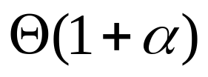
Case 1: Unsuccessful Search
(i.e., item not stored in the table)
Theorem
An unsuccessful search in a hash table takes expected time under the assumption of simple uniform hashing
(i.e., probability of collision Pr(h(x)=h(y)), is 1/m)
Proof
Searching unsuccessfully for any key k
  need to search to the end of the list T[h(k)]
Expected length of the list:
  E[n_{h(k)}] = α = n/m
Expected number of elements examined in an unsuccessful search is α
Total time required is:
  O(1) (for computing the hash function) + α →

Slide 26
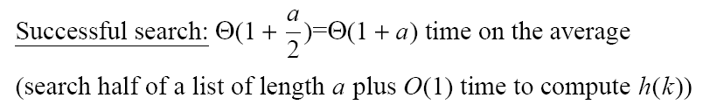
Case 2: Successful Search

Slide 27
Analysis of Search in Hash Tables
If m (# of slots) is proportional to n (# of elements in the table):
n = O(m)
α = n/m = O(m)/m = O(1)
⇒ Searching takes constant time on average

Slide 28
Hash Functions
A hash function transforms a key into a table address
What makes a good hash function?
  (1) Easy to compute
  (2) Approximates a random function: for every input, every output is equally likely (simple uniform hashing)
In practice, it is very hard to satisfy the simple uniform hashing property
  i.e., we don’t know in advance the probability distribution that keys are drawn from

Slide 29
Good Approaches for Hash Functions
Minimize the chance that closely related keys hash to the same slot
  Strings such as pt and pts should hash to different slots
Derive a hash value that is independent from any patterns that may exist in the distribution of the keys

Slide 30
The Division Method
Idea:
  Map a key k into one of the m slots by taking the remainder of k divided by m
  h(k) = k mod m
Advantage:
  fast, requires only one operation
Disadvantage:
  Certain values of m are bad, e.g.,
    power of 2
    non-prime numbers

Slide 31
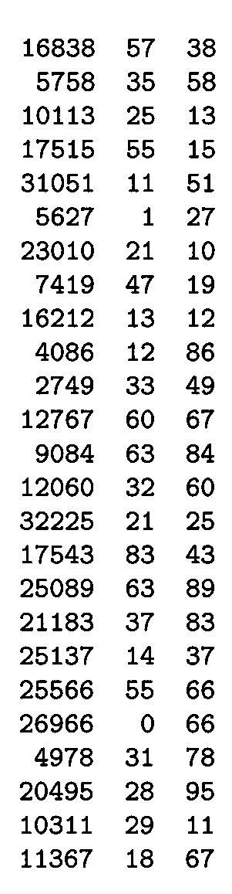
Example - The Division Method
m97
m
100
If m = 2^{p}, then h(k) is just the least significant p bits of k
  p = 1 ⇒ m = 2
  ⇒ h(k) = , least significant 1 bit of k
  p = 2 ⇒ m = 4
  ⇒ h(k) = , least significant 2 bits of k
Choose m to be a prime, not close to a
power of 2
  Column 2:
  Column 3:
{0, 1}
{0, 1, 2, 3}
k mod 97
k mod 100

Slide 32

The Multiplication Method
Idea:
Multiply key k by a constant A, where 0 < A < 1
Extract the fractional part of kA
Multiply the fractional part by m
Take the floor of the result
h(k) = = ⎣m (k A mod 1)⎦
Disadvantage: Slower than division method
Advantage: Value of m is not critical, e.g., typically 2^{p}
fractional part of kA = kA - ⎣kA⎦

Slide 33
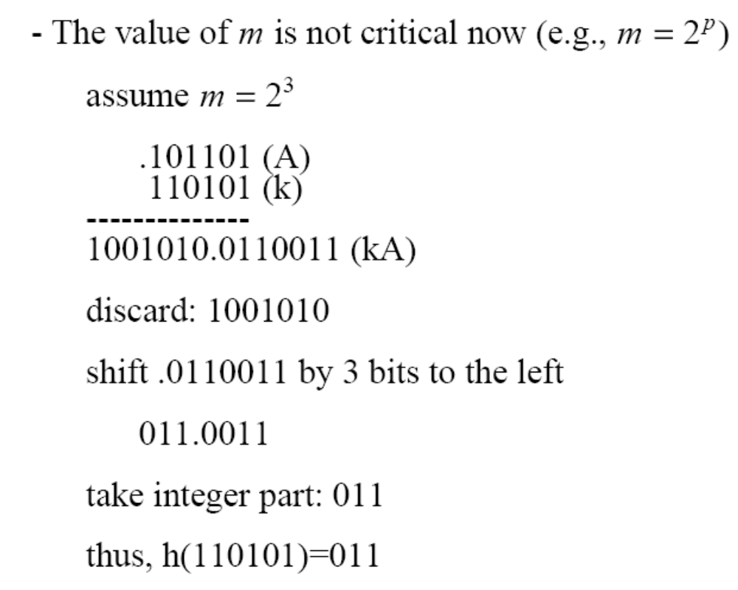
Example – Multiplication Method

Slide 34
Universal Hashing
In practice, keys are not randomly distributed
Any fixed hash function might yield Θ(n) time
Goal: hash functions that produce random table indices irrespective of the keys
Idea:
  Select a hash function at random, from a designed class of functions at the beginning of the execution

Slide 35
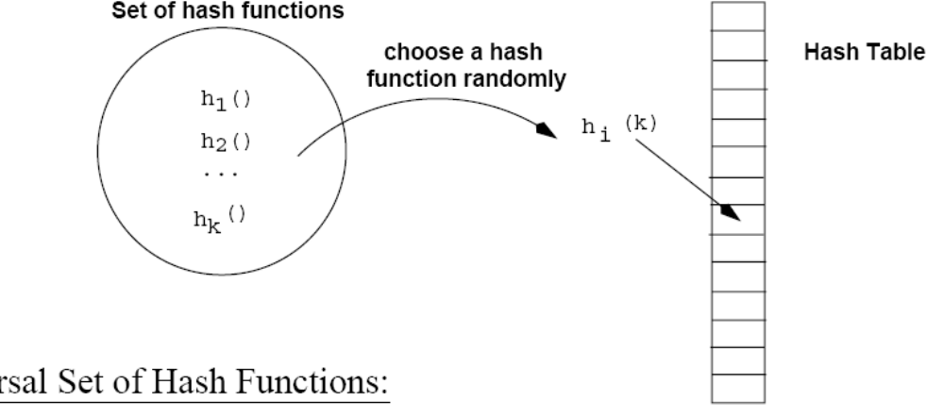
Universal Hashing
(at the beginning
of the execution)

Slide 36
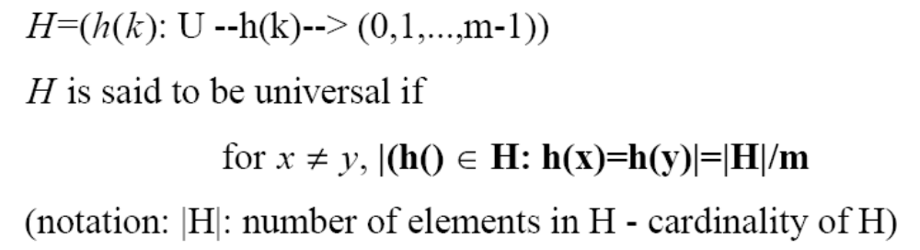
Definition of Universal Hash Functions
H={h(k): U→(0,1,..,m-1)}

Slide 37
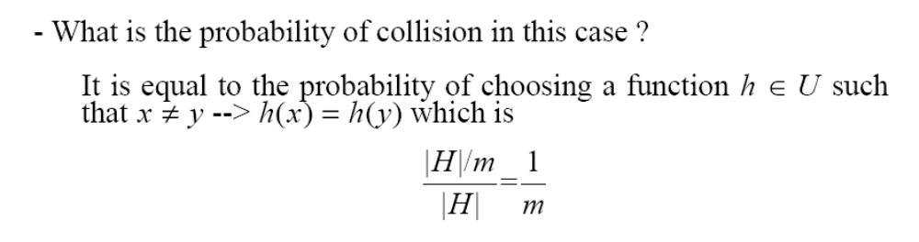
How is this property useful?
Pr(h(x)=h(y))=

Slide 38
Universal Hashing – Main Result
With universal hashing the chance of collision between distinct keys k and l is no more than the 1/m chance of collision if locations h(k) and h(l) were randomly and independently chosen from the set {0, 1, …, m – 1}

Slide 39
Designing a Universal Class of Hash Functions
Choose a prime number p large enough so that every possible key k is in the range [0 ... p – 1]
Z_{p} = {0, 1, …, p - 1} and Z_{p}* = {1, …, p - 1}
Define the following hash function
h_{a,b}(k) = ((ak + b) mod p) mod m,
∀ a ∈ Z_{p}* and b ∈ Z_{p}
The family of all such hash functions is
H_{p,m} = {h_{a,b}: a ∈ Z_{p}* and b ∈ Z_{p}}
a , b: chosen randomly at the beginning of execution
The class H_{p,m} of hash
functions is universal

Slide 40
Example: Universal Hash Functions
E.g.: p = 17, m = 6
h_{a,b}(k) = ((ak + b) mod p) mod m
h_{3,4}(8) = ((3⋅8 + 4) mod 17) mod 6
= (28 mod 17) mod 6
= 11 mod 6
= 5

Slide 41
Advantages of Universal Hashing
Universal hashing provides good results on average, independently of the keys to be stored
Guarantees that no input will always elicit the worst-case behavior
Poor performance occurs only when the random choice returns an inefficient hash function – this has small probability

Slide 42
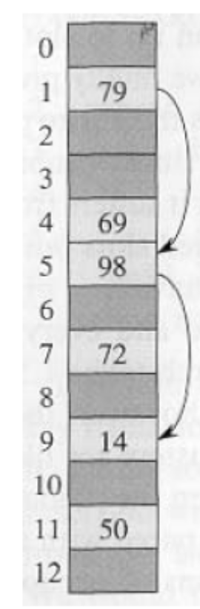
Open Addressing
If we have enough contiguous memory to store all the keys (m > N) ⇒ store the keys in the table itself
No need to use linked lists anymore
Basic idea:
  Insertion: if a slot is full, try another one,
  until you find an empty one
  Search: follow the same sequence of probes
  Deletion: more difficult ... (we’ll see why)
Search time depends on the length of the
probe sequence!
e.g., insert 14

Slide 43
Generalize hash function notation:
A hash function contains two arguments now:
  (i) Key value, and (ii) Probe number
  h(k,p), p=0,1,...,m-1
Probe sequences
<h(k,0), h(k,1), ..., h(k,m-1)>
  Must be a permutation of <0,1,...,m-1>
  There are m! possible permutations
  Good hash functions should be able to
  produce all m! probe sequences
insert 14
Example
<1, 5, 9>

Slide 44
Common Open Addressing Methods
Linear probing
Quadratic probing
Double hashing
Note: None of these methods can generate more than m² different probing sequences!

Slide 45
Linear probing: Inserting a key
Idea: when there is a collision, check the next available position in the table (i.e., probing)
h(k,i) = (h₁(k) + i) mod m
i=0,1,2,...
First slot probed: h₁(k)
Second slot probed: h₁(k) + 1
Third slot probed: h₁(k)+2, and so on
Can generate m probe sequences maximum, why?
probe sequence: < h1(k), h1(k)+1 , h1(k)+2 , ....>
wrap around

Slide 46
Linear probing: Searching for a key
Three cases:
  (1) Position in table is occupied with an element of equal key
  (2) Position in table is empty
  (3) Position in table occupied with a different element
Case 2: probe the next higher index until the element is found or an empty position is found
The process wraps around to the beginning of the table
0
h(k₁)
h(k₄)
h(k₂) = h(k₅)
h(k₃)
m - 1

Slide 47
Linear probing: Deleting a key
Problems
  Cannot mark the slot as empty
  Impossible to retrieve keys inserted after that slot was occupied
Solution
  Mark the slot with a sentinel value DELETED
The deleted slot can later be used for insertion
Searching will be able to find all the keys
0
m - 1

Slide 48
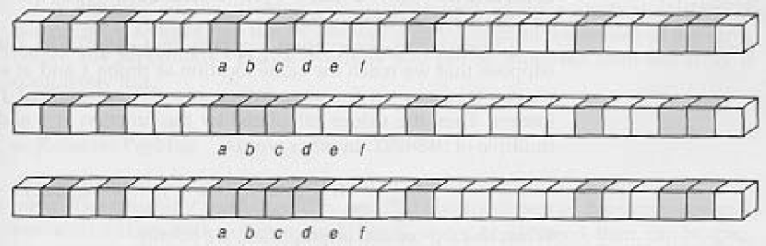
Primary Clustering Problem
Some slots become more likely than others
Long chunks of occupied slots are created
⇒ search time increases!!
initially, all slots have probability 1/m
Slot b:
2/m
Slot d:
4/m
Slot e:
5/m

Slide 49
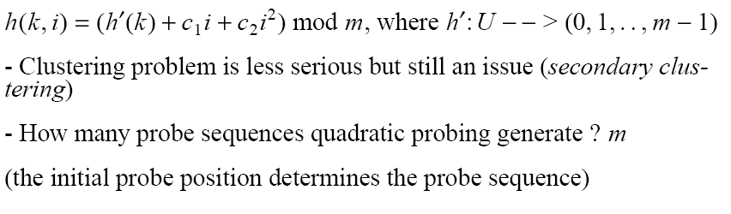
Quadratic probing
i=0,1,2,...

Slide 50
Double Hashing
(1) Use one hash function to determine the first slot
(2) Use a second hash function to determine the increment for the probe sequence
h(k,i) = (h₁(k) + i h₂(k) ) mod m, i=0,1,...
Initial probe: h₁(k)
Second probe is offset by h₂(k) mod m, so on ...
Advantage: avoids clustering
Disadvantage: harder to delete an element
Can generate m² probe sequences maximum

Slide 51
Double Hashing: Example
h₁(k) = k mod 13
h₂(k) = 1+ (k mod 11)
h(k,i) = (h₁(k) + i h₂(k) ) mod 13
Insert key 14:
h₁(14,0) = 14 mod 13 = 1
h(14,1) = (h₁(14) + h₂(14)) mod 13
= (1 + 4) mod 13 = 5
h(14,2) = (h₁(14) + 2 h₂(14)) mod 13
= (1 + 8) mod 13 = 9
0
79
69
98
72
50
1
2
3
4
5
6
7
8
9
14
10
11
12

Slide 52
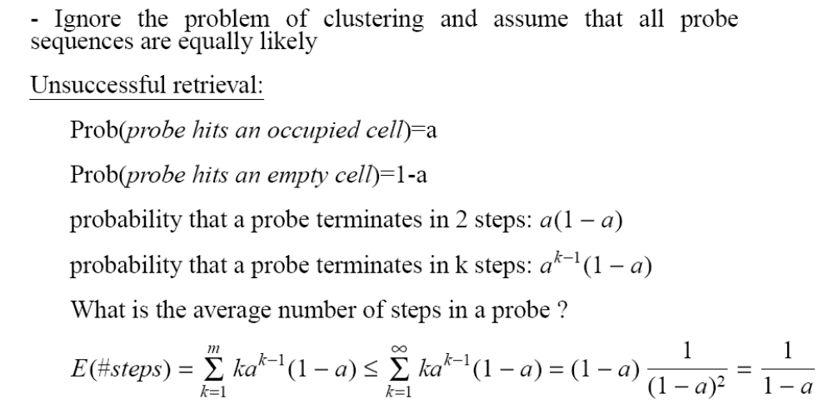

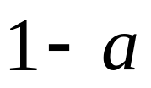
Analysis of Open Addressing
(load factor)
k=0

Slide 53
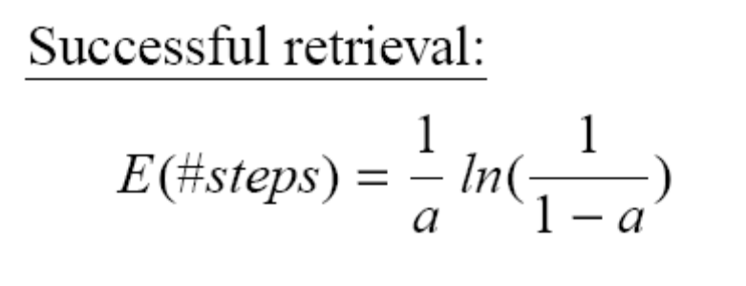
Analysis of Open Addressing (cont’d)
Example (similar to Exercise 11.4-4, page 244)
Unsuccessful retrieval:
a=0.5 E(#steps) = 2
a=0.9 E(#steps) = 10
Successful retrieval:
a=0.5 E(#steps) = 3.387
a=0.9 E(#steps) = 3.670

